Slide 1
CPSC 583 Expert Systems Design Theory
Dr. Anand Panangadan
apanangadan@fullerton.edu

Slide 2
Rest of the course
Using rules to represent decision logic
Where do rules come from?
Learning rules
Probabilistic representations of knowledge
Bayesian networks

Slide 3
What is a Decision Tree?
A predictive model based on a branching series of (Boolean) tests

Slide 4
Example of a Decision Tree
Given a person’s
Marital status
Income
Refund?
Decide if the person is likely to have cheated on his/her income tax return
Splitting Attributes
Refund
Yes
No
NO
MarSt
Single, Divorced
Married
TaxInc
NO
< 80K
> 80K
NO
YES
Decision Tree

Slide 5
Apply Model to Test Data
Test Data
Start from the root of tree.
Refund
Yes
No
NO
MarSt
Single, Divorced
Married
TaxInc
NO
< 80K
> 80K
NO
YES

Slide 6
Apply Model to Test Data
Test Data
Refund
Yes
No
NO
MarSt
Single, Divorced
Married
TaxInc
NO
< 80K
> 80K
NO
YES

Slide 7
Apply Model to Test Data
Test Data
Refund
Yes
No
NO
MarSt
Single, Divorced
Married
TaxInc
NO
< 80K
> 80K
NO
YES

Slide 8
Apply Model to Test Data
Test Data
Refund
Yes
No
NO
MarSt
Single, Divorced
Married
TaxInc
NO
< 80K
> 80K
NO
YES

Slide 9
Apply Model to Test Data
Test Data
Refund
Yes
No
NO
MarSt
Single, Divorced
Married
TaxInc
NO
< 80K
> 80K
NO
YES

Slide 10
Apply Model to Test Data
Test Data
Refund
Yes
No
NO
MarSt
Single, Divorced
Married
Assign Cheat to “No”
TaxInc
NO
< 80K
> 80K
NO
YES

Slide 11
From Decision Trees To Rules
Rules are mutually exclusive and exhaustive
Rule set contains as much information as the tree

Slide 12
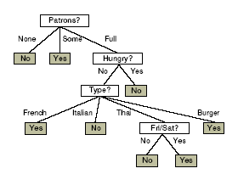
From Decision Trees To Rules
Every decision tree corresponds to set of rules:
IF (Patrons = None)
THEN WillWait = No
IF (Patrons = Full) & (Hungry = No) &(Type = French)
THEN WillWait = Yes
...

Slide 13
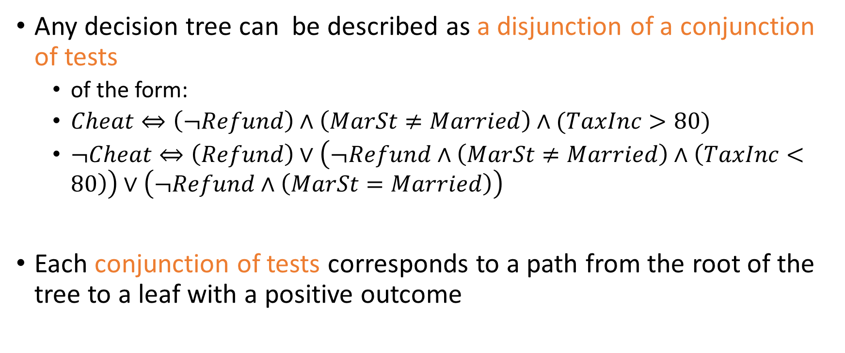
Expressiveness of Decision Trees
Any decision tree can be described as a disjunction of a conjunction of tests
of the form:
$Cheat⇔\left(¬Refund\right)∧\left(MarSt≠Married\right)∧(TaxInc>80)$
$¬Cheat⇔\left(Refund\right)∨\left(¬Refund∧\left(MarSt≠Married\right)∧\left(TaxInc<80\right)\right)∨\left(¬Refund∧\left(MarSt=Married\right)\right)$
Each conjunction of tests corresponds to a path from the root of the tree to a leaf with a positive outcome

Slide 14
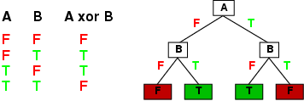
Expressiveness of Decision Trees
Decision trees can express any Boolean function of the input attributes.
E.g., for Boolean functions, truth table row → path to leaf:

Slide 15



Expressiveness of Decision Trees
A
A
A
T
F
T
F
T
F
B
B
B
B
B
B
T
F
T
F
T
F
T
F
T
F
T
F
T
F
T
T
F
F
T
T
F
T
F
F
$$\sim A∨B$$
$$¬A$$
$$A∧¬B$$

Slide 16



Expressiveness of Decision Trees
A
A
A
T
F
T
F
T
F
B
F
B
T
F
T
T
F
T
F
F
T
T
F
$$¬A$$
$$A∧¬B$$
$$\sim A∨B$$

Slide 17
Classwork
A | B | C | f(A,B,C)
false | false | false | NO
false | false | true | YES
false | true | false | NO
false | true | true | YES
true | false | false | NO
true | false | true | YES
true | true | false | NO
true | true | true | NO
Create the smallest decision tree that you can to represent this function:

Slide 18
How to implement a decision tree in CLIPS?
A generic tree processing program
Two kinds of nodes
Decision nodes (interior nodes)
Answer nodes (leaves)

Slide 19
How to implement a decision tree using rules?
(node
(name leaf1)
(type answer)
(answer NO))
Refund
Yes
No
NO
MarSt
Single, Divorced
Married
TaxInc
NO
< 80K
> 80K
NO
YES

Slide 20
How to implement a decision tree using rules?
(node
(name refund)
(type decision)
(question “Did they get a refund?”)
(yes-node leaf1)
(no-node MarSt))
Refund
Yes
No
NO
MarSt
Single, Divorced
Married
TaxInc
NO
< 80K
> 80K
NO
YES

Slide 21
How to implement a decision tree using rules?
(deftemplate node
(slot name)
(slot type)
(slot question)
(slot yes-node)
(slot no-node)
(slot answer))

Slide 22
How to implement a decision tree using rules?
(deftemplate node
(slot name)
(slot type)
(slot question)
(slot yes-node)
(slot no-node)
(slot answer))
(deffacts AllNodes
(node
(name Refund)
(type decision)
(question "Did person get a refund?")
(yes-node Leaf1)
(no-node Married))
(node
(name Leaf1)
(type answer)
(answer NO))
)
Refund
Yes
No
NO
MarSt
Single, Divorced
Married
TaxInc
NO
< 80K
> 80K
NO
YES

Slide 23
How to implement a decision tree using rules?
(defrule set-root-node
(initial-fact)
=>
(assert (current-node Refund))
)
Refund
Yes
No
NO
MarSt
Single, Divorced
Married
TaxInc
NO
< 80K
> 80K
NO
YES

Slide 24
How to implement a decision tree using rules?
(defrule ask-decision-node-question
(current-node ?name)
(node (name ?name)
(type decision)
(question ?question))
(not (answer ?))
=>
(assert (answer (ask-yes-or-no ?question)))
)
(deffunction ask-yes-or-no (?question)
(printout t ?question " (yes or no) " )
(bind ?answer (read))
(return ?answer)
)
Refund
Yes
No
NO
MarSt
Single, Divorced
Married
TaxInc
NO
< 80K
> 80K
NO
YES

Slide 25
How to implement a decision tree using rules?
(defrule process-yes-branch
(current-node ?name)
(node (name ?name)
(type decision)
(yes-node ?yes-branch))
(answer yes)
=>
(assert (current-node ?yes-branch))
)
Refund
Yes
No
NO
MarSt
Single, Divorced
Married
TaxInc
NO
< 80K
> 80K
NO
YES

Slide 26
How to implement a decision tree using rules?
(defrule process-yes-branch
?node <- (current-node ?name)
(node (name ?name)
(type decision)
(yes-node ?yes-branch))
?answer <- (answer yes)
=>
(retract ?node ?answer)
(assert (current-node ?yes-branch))
)
Similarly for no-branch
Refund
Yes
No
NO
MarSt
Single, Divorced
Married
TaxInc
NO
< 80K
> 80K
NO
YES

Slide 27
How to implement a decision tree using rules?
(defrule process-answer-node
(current-node ?name)
(node (name ?name)
(type answer)
(answer NO))
=>
(printout t "The person did NOT cheat" crlf)
(halt)
)
Similarly for NO node.
Refund
Yes
No
NO
MarSt
Single, Divorced
Married
TaxInc
NO
< 80K
> 80K
NO
YES

Slide 28
Classwork
Complete the decisiontree.clp CLIPS program to implement the decision tree
Refund
Yes
No
NO
MarSt
Single, Divorced
Married
TaxInc
NO
< 80K
> 80K
NO
YES

Slide 29
How to implement a decision tree using rules?
Can do this for any decision tree
Useful approach for your project

Slide 30
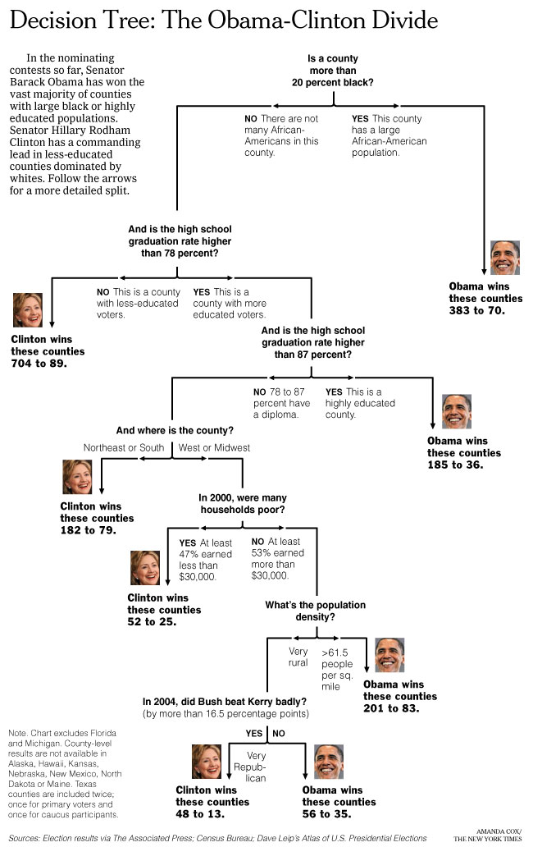
New York Times
April 16, 2008
How can we learn such a complex tree?

Slide 31
Classification: Definition
Given a collection of records (training set )
Each record contains a set of attributes, one of the attributes is the class.
Find a model for class attribute as a function of the values of other attributes.
Goal: previously unseen records should be assigned a class as accurately as possible.
A test set is used to determine the accuracy of the model. Usually, the given data set is divided into training and test sets, with training set used to build the model and test set used to validate it.

Slide 32
Example

Slide 33

Applications of Classification
Predicting tumor cells as benign or malignant
Classifying credit card transactions as legitimate or fraudulent
Categorizing news stories as finance, weather, entertainment, sports

Slide 34
Classification Techniques
Decision Tree based Methods
Naïve Bayes and Bayesian Belief Networks
Neural Networks
Support Vector Machines

Slide 35
Example of a Decision Tree
categorical
categorical
continuous
class
Splitting Attributes
Refund
Yes
No
NO
MarSt
Single, Divorced
Married
TaxInc
NO
< 80K
> 80K
NO
YES
Training Data
Model: Decision Tree

Slide 36
Another Example of a Decision Tree
categorical
categorical
continuous
class
MarSt
Single, Divorced
Married
NO
Refund
Yes
No
NO
TaxInc
< 80K
> 80K
NO
YES
There could be more than one tree that fits the same data!

Slide 37
Decision Tree Classification Task
Decision Tree

Slide 38
Apply Model to Test Data
Test Data
Start from the root of tree.
Refund
Yes
No
NO
MarSt
Single, Divorced
Married
TaxInc
NO
< 80K
> 80K
NO
YES

Slide 39
Apply Model to Test Data
Test Data
Refund
Yes
No
NO
MarSt
Single, Divorced
Married
TaxInc
NO
< 80K
> 80K
NO
YES

Slide 40
Apply Model to Test Data
Test Data
Refund
Yes
No
NO
MarSt
Single, Divorced
Married
TaxInc
NO
< 80K
> 80K
NO
YES

Slide 41
Apply Model to Test Data
Test Data
Refund
Yes
No
NO
MarSt
Single, Divorced
Married
TaxInc
NO
< 80K
> 80K
NO
YES

Slide 42
Apply Model to Test Data
Test Data
Refund
Yes
No
NO
MarSt
Single, Divorced
Married
TaxInc
NO
< 80K
> 80K
NO
YES

Slide 43
Apply Model to Test Data
Test Data
Refund
Yes
No
NO
MarSt
Single, Divorced
Married
Assign Cheat to “No”
TaxInc
NO
< 80K
> 80K
NO
YES

Slide 44
Decision tree learning
Decision Tree Induction
Finding a decision tree that agrees with data

Slide 45
A decision problem
Problem: decide whether to wait for a table at a restaurant, based on the following attributes:
1. Alternate: is there an alternative restaurant nearby?
2. Bar: is there a comfortable bar area to wait in?
3. Fri/Sat: is today Friday or Saturday?
4. Hungry: are we hungry?
5. Patrons: number of people in the restaurant (None, Some, Full)
6. Price: price range ($, $$, $$$)
7. Raining: is it raining outside?
8. Reservation: have we made a reservation?
9. Type: kind of restaurant (French, Italian, Thai, Burger)
10. WaitEstimate: estimated waiting time (0-10, 10-30, 30-60,>60)
Decision: WAIT or NOT WAIT (T/F)?

Slide 46
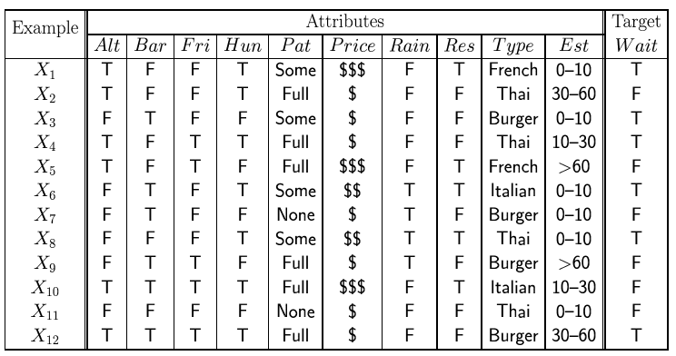
Training data
Examples described by attribute values (Boolean, discrete, continuous)
E.g., situations where I will/won't wait for a table at a restaurant:
Classification of examples is positive (T) or negative (F)
12 examples
6 +
6 -

Slide 47
Decision tree learning
Naïve approach
Construct a decision tree that has one path to a leaf for each example
Each path tests sets each attribute value to the value of the example
Problem: This just memorizes examples. What about new data? It doesn’t generalize
Prefer a compact/smallest tree

Slide 48
Decision tree learning
Prefer a compact/smallest tree
Occam’s Razor
“All other things being equal, choose the simplest explanation”
Find the smallest tree that classifies the data correctly
Problem
Finding the smallest tree consistent with the examples is NP-hard

Slide 49

Size of hypothesis space
How many distinct decision trees with n Boolean attributes?
= number of Boolean functions
= number of distinct truth tables with 2^{n} rows = $2^{2^{n}}$

Slide 50
Decision tree learning algorithm
Overall Goal: get a good classification with a small number of tests
Key problem:
Which attribute to test first?
Approach
Use heuristic search (greedy search)
Key idea:
Pick attribute that maximizes information as the root node

Slide 51
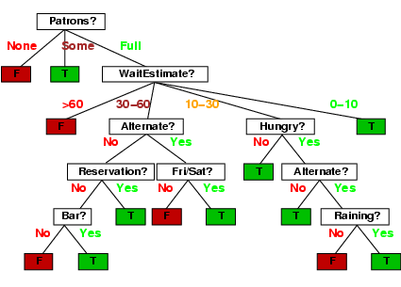
Decision tree

Slide 52
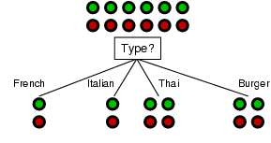
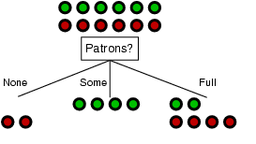
Choosing an attribute
Goal: trees with short paths to leaf nodes
Which one should we pick?
A perfect attribute would divide the examples into subsets that are all positive or all negative
maximum information gain

Slide 53
Information Gain
How to measure the “usefulness” of an attribute
how well attribute separates examples according to their labels (+/-)
Measure from Information Theory

Slide 54
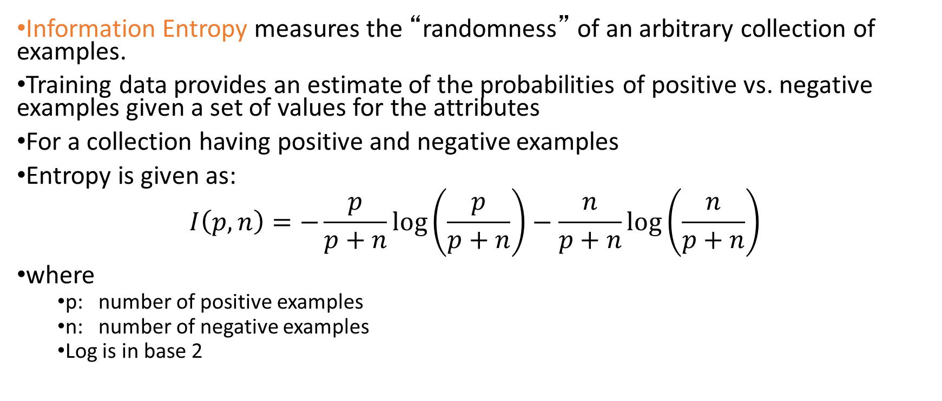
Information Entropy
Information Entropy measures the “randomness” of an arbitrary collection of examples.
Training data provides an estimate of the probabilities of positive vs. negative examples given a set of values for the attributes
For a collection having positive and negative examples
Entropy is given as:
$$I\left(p,n\right)=−\frac{p}{p+n}\log\left(\frac{p}{p+n}\right)−\frac{n}{p+n}\log\left(\frac{n}{p+n}\right)$$
where
p: number of positive examples
n: number of negative examples
Log is in base 2

Slide 55
Entropy of example dataset
Situations where I will/won't wait for a table:
What’s the entropy of this collection of examples?
p = 6; n = 6; I(6,6) = -0.5 log(0.5) –0.5 log(0.5) = 1
Need 1 bit of information to classify a randomly picked example from this data
12 examples
6 +
6 -

Slide 56
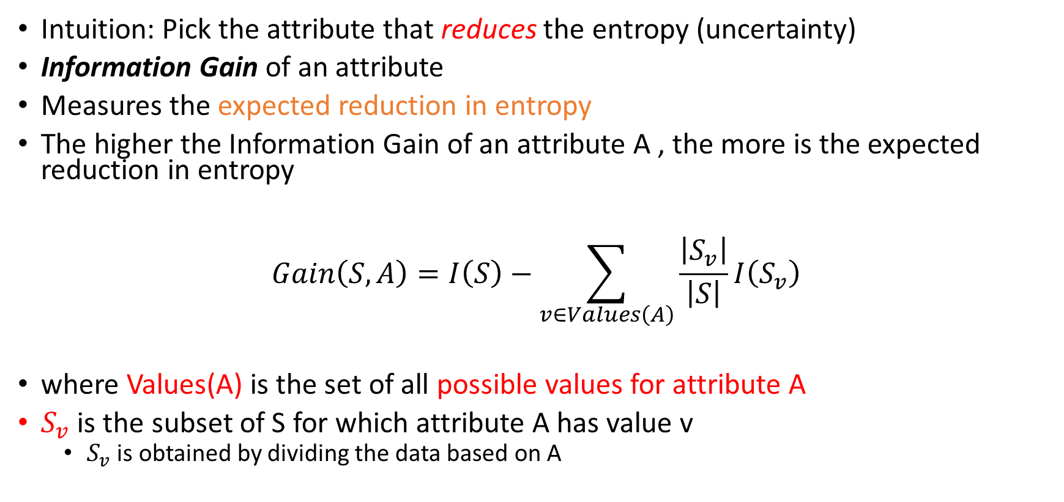
Information Gain
Intuition: Pick the attribute that reduces the entropy (uncertainty)
Information Gain of an attribute
Measures the expected reduction in entropy
The higher the Information Gain of an attribute A , the more is the expected reduction in entropy
$$Gain\left(S,A\right)=I\left(S\right)−\sum_{v∈Values\left(A\right)}{\frac{\left|S_{v}\right|}{\left|S\right|}I\left(S_{v}\right)}$$
where Values(A) is the set of all possible values for attribute A
$S_{v}$ is the subset of S for which attribute A has value v
$S_{v}$ is obtained by dividing the data based on A

Slide 57
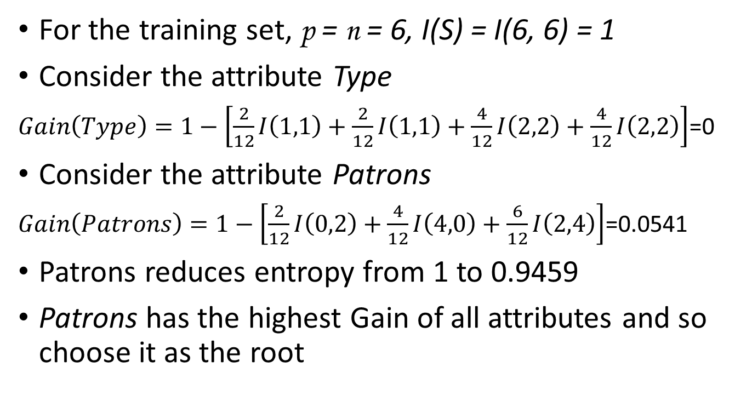
Information gain
For the training set, p = n = 6, I(S) = I(6, 6) = 1
Consider the attribute Type
$Gain\left(Type\right)=1−\left[\frac{2}{12}I\left(1,1\right)+\frac{2}{12}I\left(1,1\right)+\frac{4}{12}I\left(2,2\right)+\frac{4}{12}I\left(2,2\right)\right]$=0
Consider the attribute Patrons
$Gain\left(Patrons\right)=1−\left[\frac{2}{12}I\left(0,2\right)+\frac{4}{12}I\left(4,0\right)+\frac{6}{12}I\left(2,4\right)\right]$=0.0541
Patrons reduces entropy from 1 to 0.9459
Patrons has the highest Gain of all attributes and so choose it as the root

Slide 58
Classwork
Compute whether Hungry or Type is the better attribute after Patrons is made the root
Patrons?
Full
None
Some
?
?
Hungry? or Type?

Slide 59
Classwork solution
Hungry:
True: (2,2)
False(0,2)
Expected Information = (4/6)*I(2,2) + (2/6)*I(0,2)=0.667
Hun | Wait
T | F
T | T
F | F
F | F
T | F
T | T
Type | Wait
Thai | F
Thai | T
French | F
Burger | F
Italian | F
Burger | T
Type:
Thai: (1,1)
French(0,1)
Burger: (1,1)
Italian: (0,1)
Expected Information = (2/6)*I(1,1) + (1/6)*I(0,1) + (2/6)*I(1,1) + (1/6)*I(0,1)=0.667

Slide 60
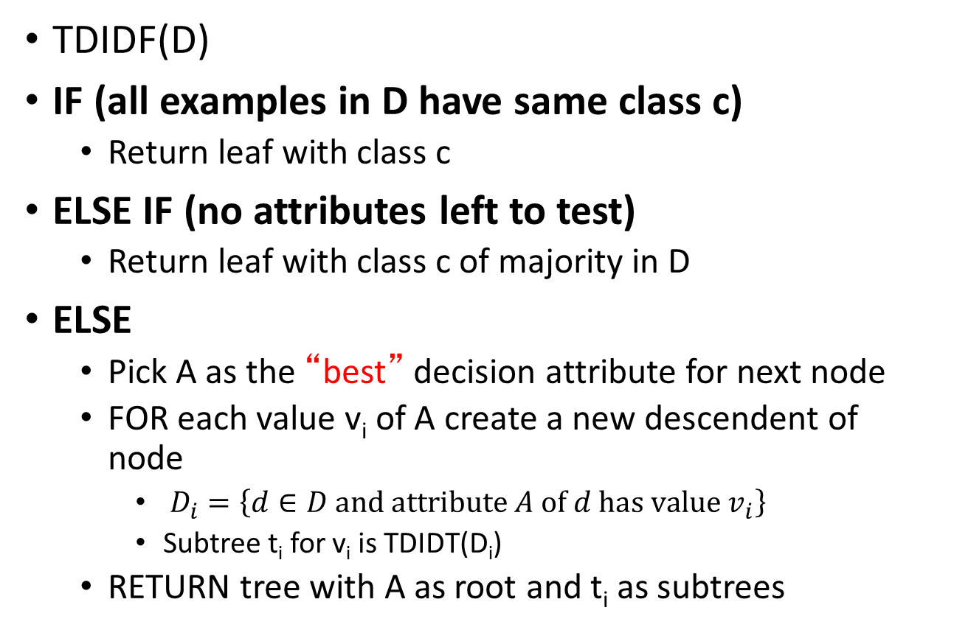
Recursive algorithm for DT induction
TDIDF(D)
IF (all examples in D have same class c)
Return leaf with class c
ELSE IF (no attributes left to test)
Return leaf with class c of majority in D
ELSE
Pick A as the “best” decision attribute for next node
FOR each value v_{i} of A create a new descendent of node
$D_{i}=\left\{d∈D and attribute A of d has value v_{i}\right\}$
Subtree t_{i} for v_{i} is TDIDT(D_{i})
RETURN tree with A as root and t_{i} as subtrees

Slide 61
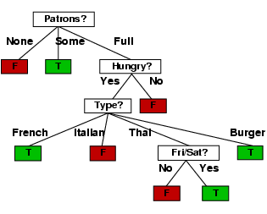
Decision tree learned from the 12 examples

Slide 62
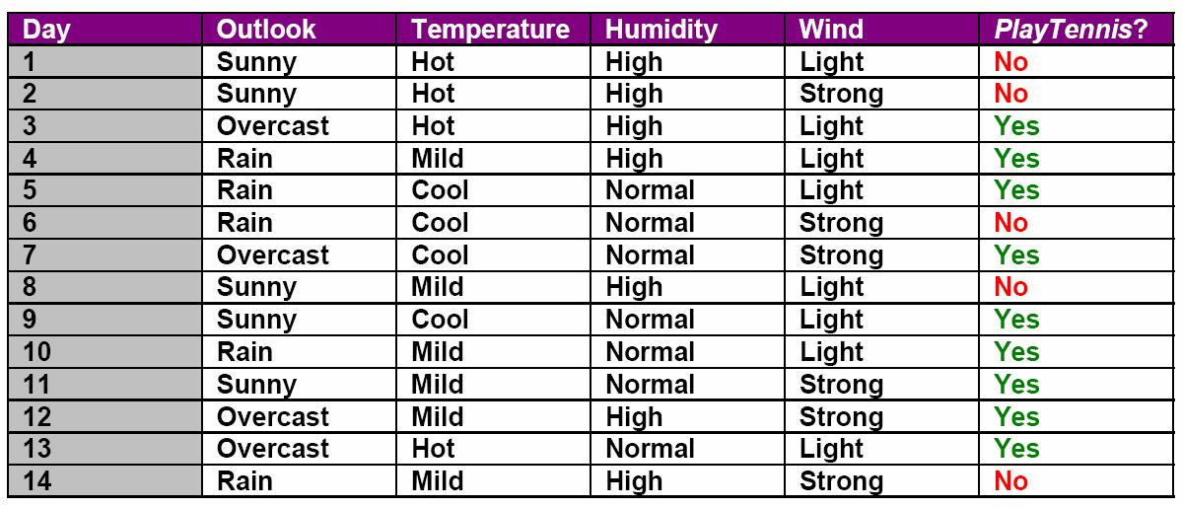
Another example
Which feature (Outlook, Temperature, Humidity, or Wind) is most important to decide if PlayTennis is Yes or No using the principle of Information Gain?

Slide 63
ID3 Algorithm
The entropy-based method is called the ID3 algorithm
Developed in 1975

Slide 64
Inductive Bias
ID3 algorithm prefers
shorter trees over deeper/more complex ones
ones with high gain attributes near root

Slide 65
Problems with ID3
ID3 is not optimal
Does not consider all combinations of parameters
Commits to some at the beginning itself
Must use discrete (or discretized) attributes
Must break down continuous attributes into a set of discrete ranges

Slide 66
Problems with Decision Trees
While decision trees classify quickly, the time for building a tree may be higher than other types of classifiers
Errors propagate throughout a tree
A serious problem as the number of classes increases

Slide 67
Error Propagation
Final answer after a series of single variable decisions
What is one of these variable values is wrong?
Every decision from that point on may be wrong
May never return to the correct path of the tree

Slide 68
Evaluation of decision trees
How good is the tree we learned in practice?

Slide 69
How well does it work?
Decision trees are at least as accurate as human experts in some domains
A study for diagnosing breast cancer had humans correctly classifying the examples 65% of the time, and the decision tree classified 72% correct.
British Petroleum designed a decision tree for gas-oil separation for offshore oil platforms that replaced an earlier rule-based expert system.
Cessna designed an airplane flight controller using 90,000 examples and 20 attributes per example.

Slide 70
Evaluation Methodology
How to evaluate the quality of a learning algorithm, i.e.,:
How good are the hypotheses produce by the learning algorithm?
How good are they at classifying unseen examples?
Notes:
Peeking – example of peeking:
We generate four different hypothesis – for example by using different criteria to pick the next attribute to branch on.
We test them on the test set and we select the best hypothesis – voila’ – there was picking since the hypothesis was selcted on the basis of its performance on the test set, so information about the test set has leaked into the learning algorithm.

Slide 71
Performance Measures
Error Rate
Fraction (or percentage) of false predictions
Accuracy
Fraction (or percentage) of correct predictions
Precision/Recall
Binary classification problems (two classes: positive/negative)
Precision: Fraction (or percentage) of correct predictions among all examples predicted to be positive
Recall: Fraction (or percentage) of correct predictions among all real positive examples
(Can be generalized to multi-class case.)

Slide 72
Test/Training Split
Real-world Process
drawn randomly
split randomly
Data D
split randomly
Training Data D_{train}
Test Data D_{test}
(x₁,y₁), …, (x_{n},y_{n})
D_{train}
h
(x₁,y₁),…(x_{k},y_{k})
Learner
Notes:
Goal: Decouple algorithm testing from real-world process time constraints
Example: Drug effectiveness prediction (some problems with non iid for spam and stock)

Slide 73
Overfitting
Some attributes are irrelevant to the decision-making process
But the decision tree learning algorithm does not know which
Example:
Problem of trying to predict the roll of a die
The experiment data includes
Color
Day of week
All are irrelevant to its outcome but the ID3 algorithm will use these to differentiate examples

Slide 74
Overfitting
If the hypothesis space has many dimensions because of a large number of attributes:
There will be meaningless regularity in the data just from random chance
Irrelevant to the true, important, distinguishing features

Slide 75
Overfitting
Overfitting: fitting the model (decision tree) to the training set “too well”
Performance on the test set degrades.
Example of overfitting risk parameter for wait-at-restaurant decision?
Using restaurant name.

Slide 76
Overfitting
D: the entire distribution of data
T: the training set
Hypothesis (decision tree) h ∈ H overfits D if
∃ h’≠ h ∈ H such that
error_{T}(h) < error_{T}(h’) but
error_{D}(h) > error_{D}(h’)
Note: can only estimate error on full distribution by using a test data set

Slide 77
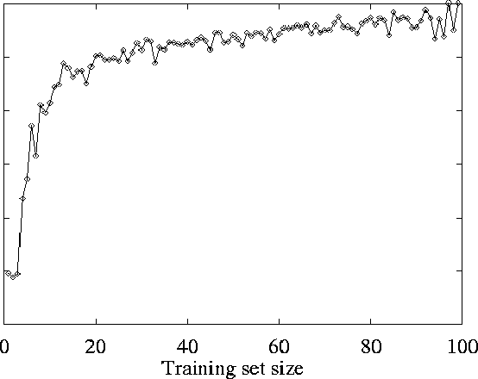
Learning Curve
On test set
Prediction quality:
Average Proportion correct on test set
As the training set increases,
so does the quality of prediction
→ the learning algorithm is able to capture
the pattern in the data

Slide 78
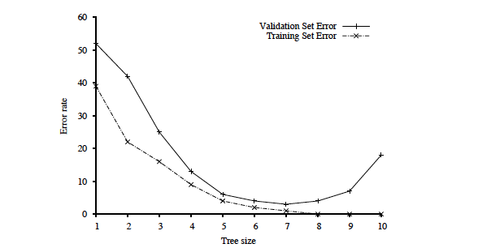
Optimal tree size
Tree size as
a parameter in our
DT learning alg.
Error rate
Overfitting kicks in…
Tree size
With larger and larger trees,
we just do better and better on the training set!
But performance on the validation set decreases

Slide 79
Reasons for watching out for over-fitting
Many kinds of "noise" that could occur in the examples:
Two examples have same attribute/value pairs, but different classifications
→report majority classification for the examples corresponding to the node
deterministic hypothesis.
→report estimated probabilities of each classification using the relative frequency (if considering stochastic hypotheses)
Some values of attributes are incorrect because of errors in the data acquisition process or the preprocessing phase
The classification is wrong (e.g., + instead of -) because of some error

Slide 80
Model selection
To determine validation error for each tree size, use k-fold cross-validation.
More efficient use of data than “holdout cross-validation”
Split all data k times into a training set and a validation set.
After right decision tree size is found from the error rate curve on validation data, train on all training data to get final decision tree (for deployment).
Finally, evaluate tree on the test data (not used before) to get true generalization error (to unseen examples).

Slide 81
Holdout Cross-Validation
1. Collect a large set of examples.
2. Randomly divide collection into two disjoint sets: training set and test set.
3. Apply learning algorithm to training set generating tree h
4. Measure performance of h w.r.t. test set
→ measures generalization to unseen data
keep the training and test sets disjoint! “No peeking”!
Notes:
Peeking – example of peeking:
We generate four different hypothesis – for example by using different criteria to pick the next attribute to branch on.
We test them on the test set and we select the best hypothesis – voila’ – there was picking since the hypothesis was selcted on the basis of its performance on the test set, so information about the test set has leaked into the learning algorithm.

Slide 82
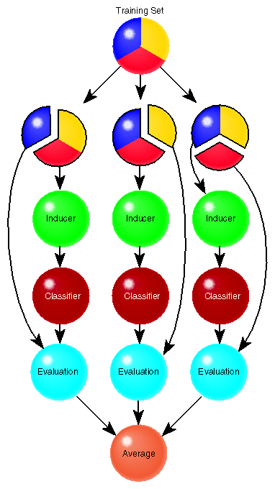
3-fold cross-valiadtion

Slide 83
Fixing overfitting for decision trees
Fix by pruning to smaller number of nodes in the decision tree
Limit the number of nodes created
If Information Gain of the best attribute at a node is below a threshold, stop and make this node a leaf rather than generating children nodes.

Slide 84
From Decision Trees To Rules
Every decision tree corresponds to set of rules:
IF (Patrons = None)
THEN WillWait = No
IF (Patrons = Full) & (Hungry = No) &(Type = French)
THEN WillWait = Yes
...

Slide 85
From Decision Trees To Rules
Rules are mutually exclusive and exhaustive
Rule set contains as much information as the tree

Slide 86
Rules Can Be Simplified
Initial Rule: (Refund=No) ∧ (Status=Married) → No
Simplified Rule: (Status=Married) → No

Slide 87
Classwork
Write the rule(s) that describe the longest path in this decision tree
For this rule, list all the simplifications

Slide 88
Pruning a tree to improve generalization
Build a decision tree using all the data
Convert decision tree to equivalent set of rules
One rule per path from root to leaf
Prune (generalize) each rule independent of the others
Delete preconditions that improve its accuracy
Sort simplified rules by giving a priority to each rule
Simplified rules may not be mutually exclusive
More than one rule may apply for a given set of attributes
Use sorted rule set for classification

Slide 89
Pruning a tree to improve generalization
Strategy of one of the most successful decision tree learning algorithm
C4.5
Widely used in Data Mining

Slide 90
Summary
Decision tree learning is a particular case of supervised learning
Aim is to find a “simple” hypothesis approximately consistent with training examples
ID3 decision tree learning algorithm uses information gain
Performance of the learnt classifier:
Prediction accuracy measured on test set
Cross-validation to reduce over-fitting

